Slide 1
Garbage Classification - Based on Rules of Shanghai Garbage Classification System
Group 27
Li Guoshen A0237348X/ An Yuhong A0254379R/ He Wenbin A0237325H

Slide 2
Contents
01.
Introduction
05.
ANN
02.
Methodology
06.
Visualization
03.
MLP
07.
Conclusion
04.
CNN
08.
References

Slide 3
01
Introduction

Slide 4
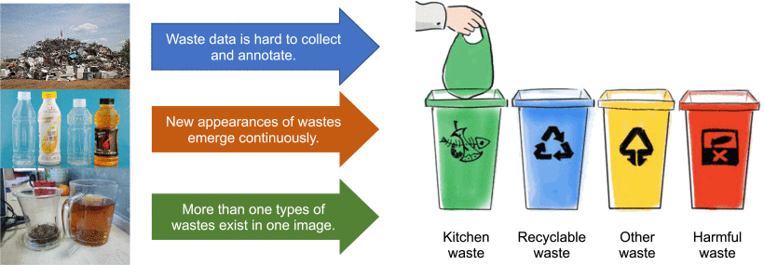
Introduction
Problem Description:
An inevitable consequence of intense human activities is the rapid increase in the amount of waste that is produced, and it is the way these waste are handled, stored, collected, and disposed of, which can pose risks to the environment and to public health. At the heart of waste disposal is reasonable waste classification. ①Although different countries/cities may have proposed the details for garbage classification, it is not realistic for people to classify them without intelligent tools. As an increasingly detailed understanding of the different degrees of environmental, social, and economic risks associated with managing various types of ‘waste’ has developed, a variety of systems have been established to differentiate between materials. ②However, most available systems do not accept pictures as input, which makes it difficult for citizens to inquire about waste types.
Challenges of vision-based garbage classification for waste recycling.[1]

Slide 5
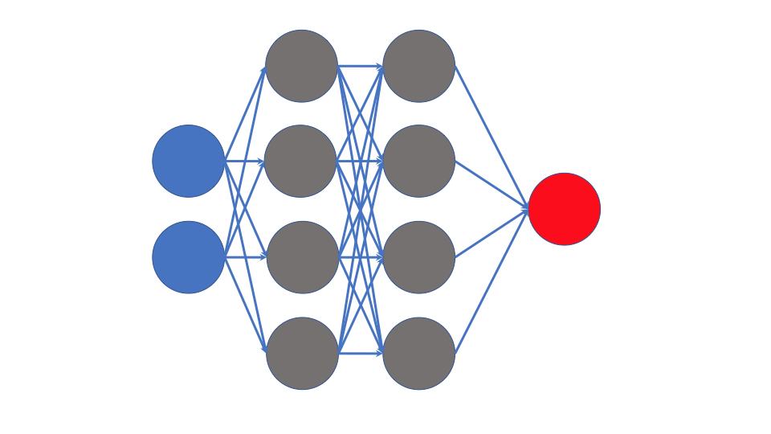
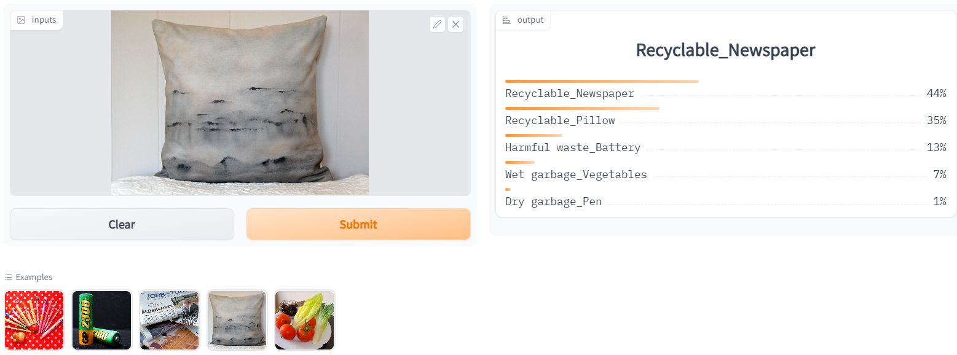
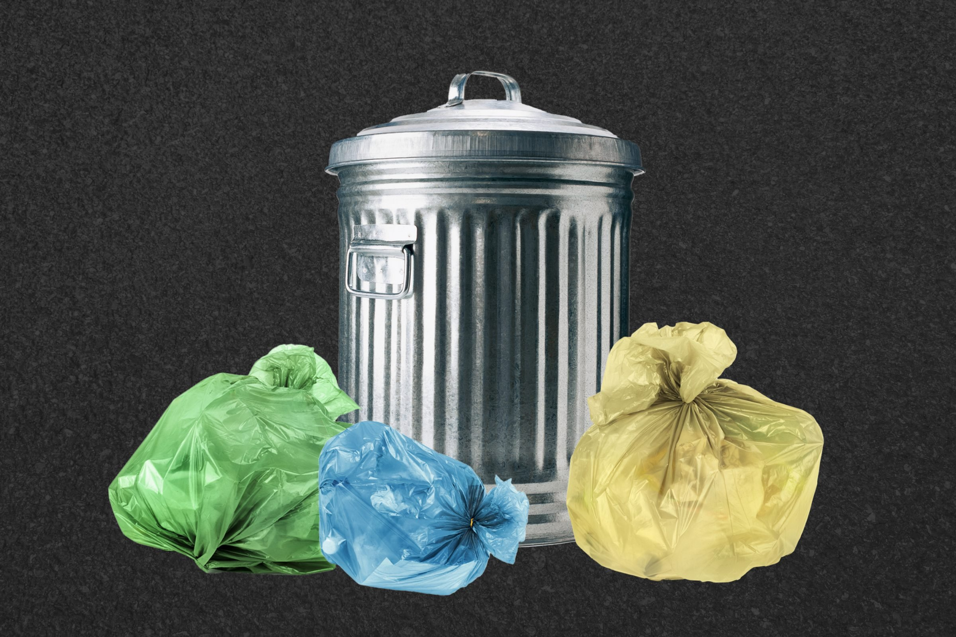
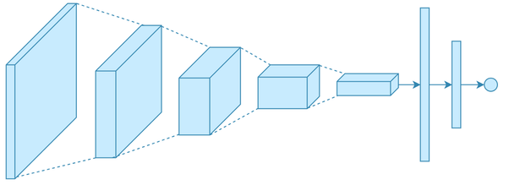
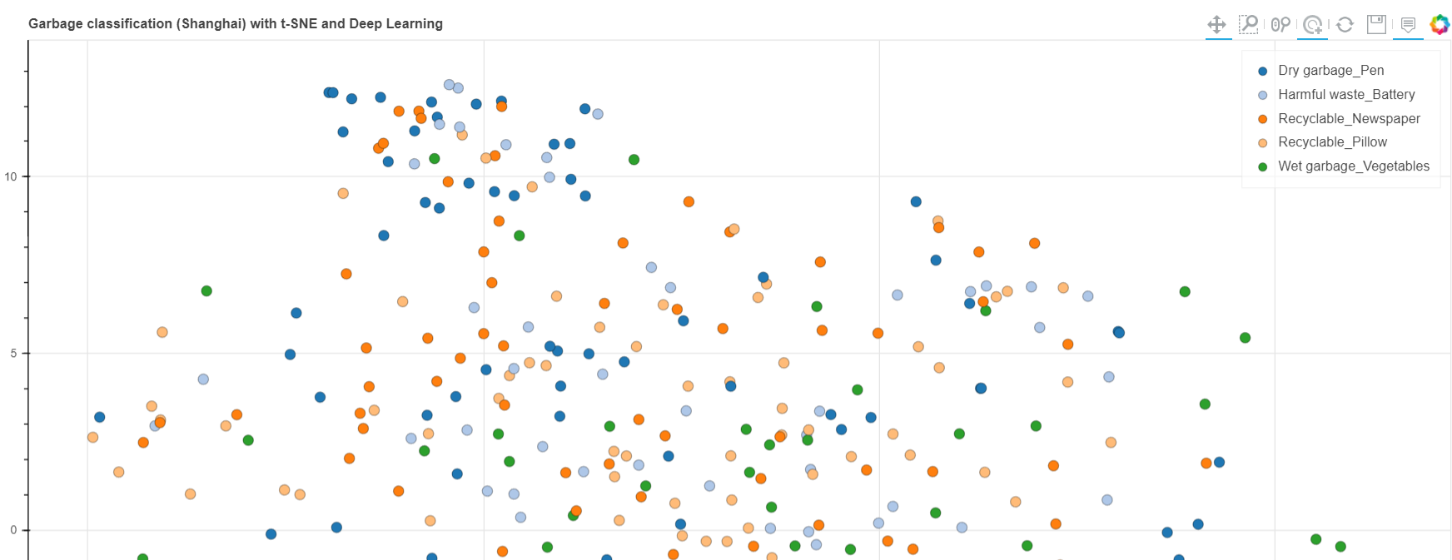
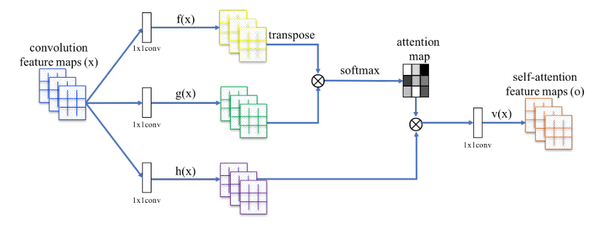
Introduction
Motivation:
Our algorithm model and solution therefore complements the gap between legislation and practice by developing an image-based waste sorting system, which assists users to understand the characteristics of waste so that it can be managed and monitored appropriately in a manner that protects human health and the environment. Based on the optimal model among MLP, CNN, and ANN, users can get quick and accurate judgments on the waste types, improving the garbage classification quality. Also, a simple front-end layer is included in our solution that allows users to interact easily.
Trash types used in our project
Trash type | Index
Dry garbage_Pen | 0
Harmful waste_Battery | 1
Recyclable_Newspaper | 2
Recyclable_Pillow | 3
Wet garbage_Vegetables | 4
MLP
Gradio App
CNN
Images
ANN
Bokeh Visualization

Slide 6
Introduction
Tasks for each member:
Name | Tasks
An Yuhong | Majorly working on attention network such as transformer. Helping dataset acquisition & preprocessing and model training work
He Wenbin | Majorly working on MLP & CNN models and evaluation & interpretation. Develop a suitable front-end layer for solution. Summarize content and integrate reports
Li Guoshen | Majorly working on using class activation map for neural network interpretability, incorporate attention block in CNN, and help model training. Helping and advising on data pre-processing work

Slide 7
02
Methodology

Slide 8

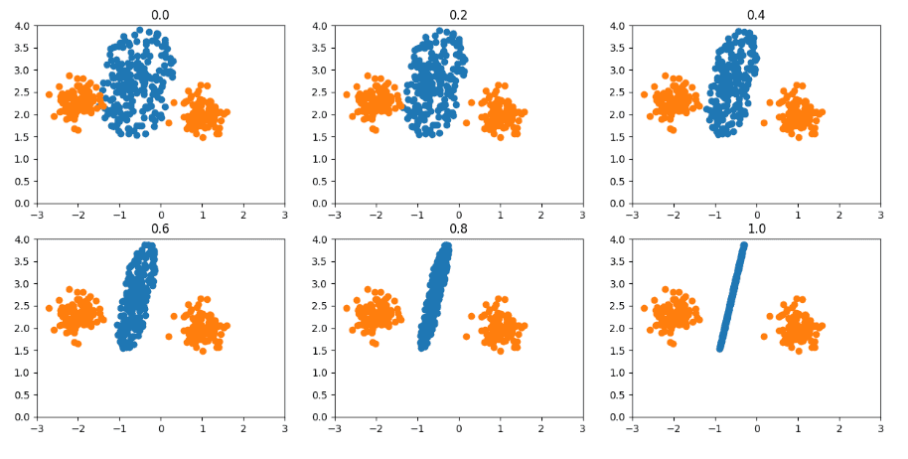
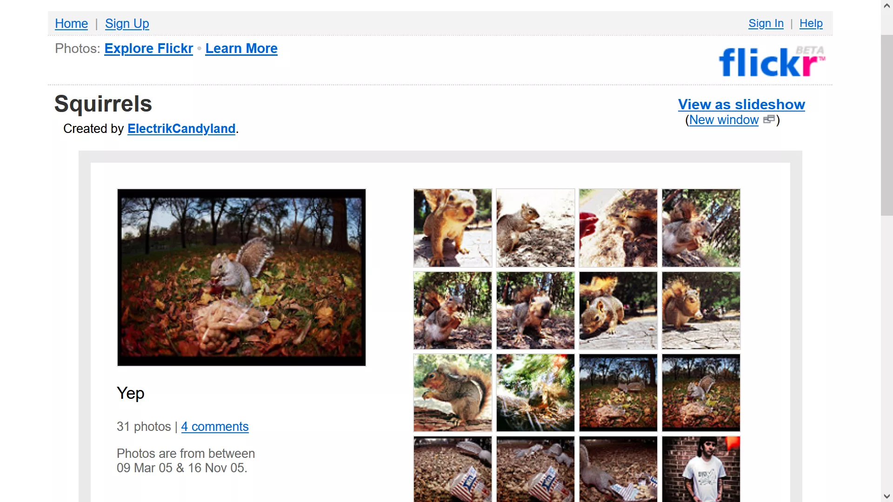

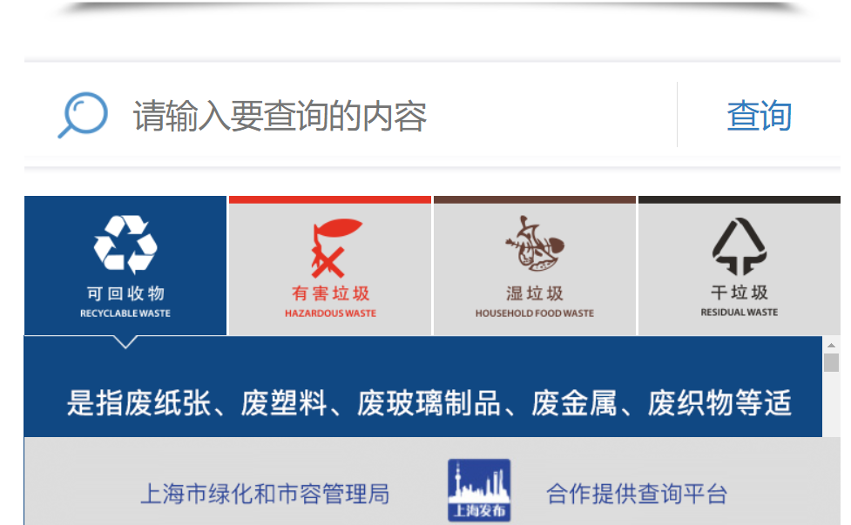
Methodology
Baidu English Translation
Data Pre-processing
Chinese -> English
Over sampling - Geometric Smote
Resnet50+Kmeans remove images
Trash Type Query
Flickr Image Crawler
Model Construction
Shanghai Garbage
Classification System
Download Images through Flickr API
MLP, CNN, ANN

Slide 9
03
MLP

Slide 10
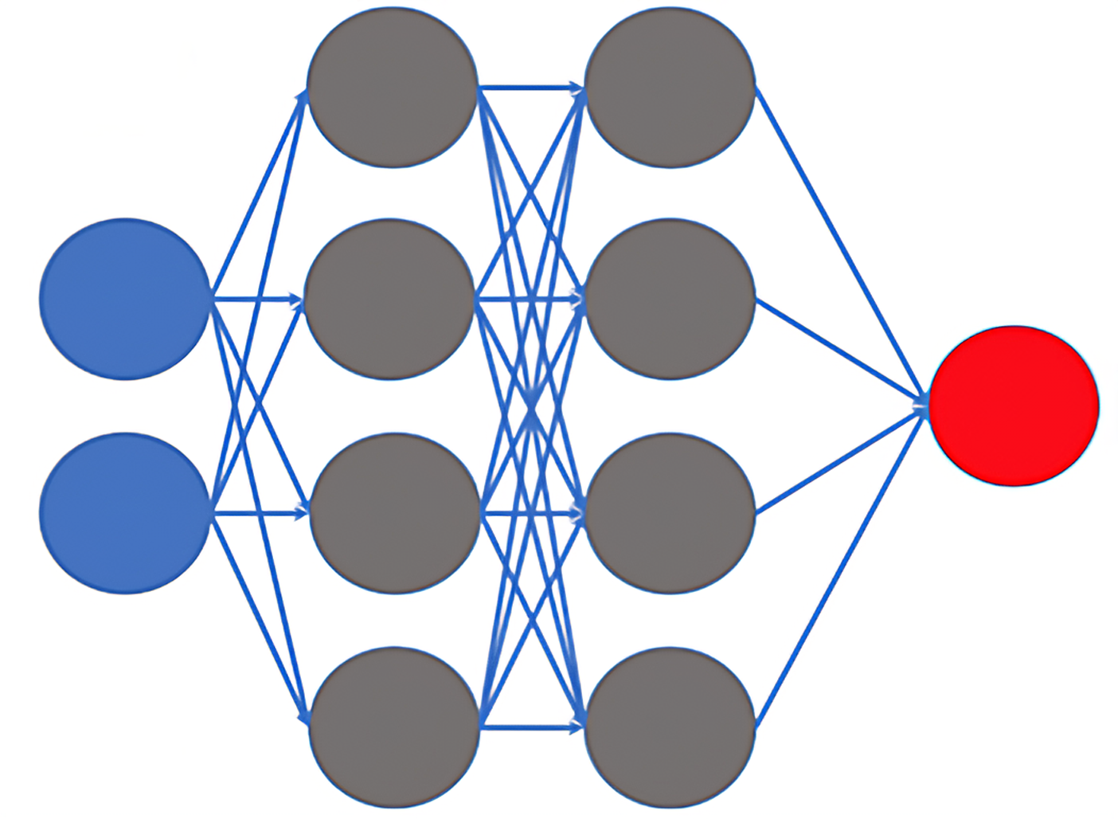
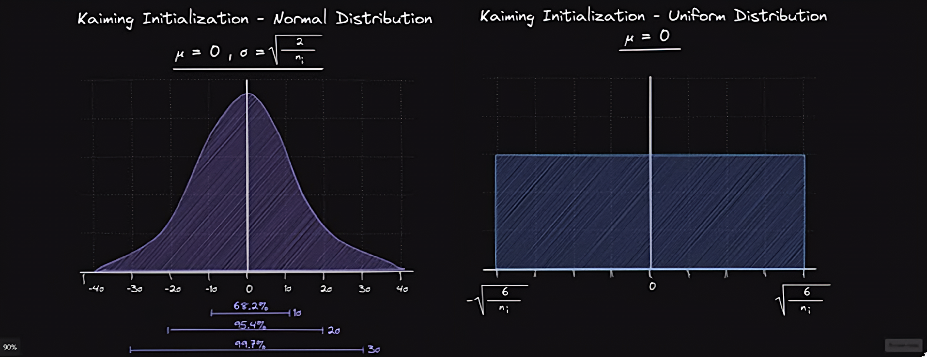
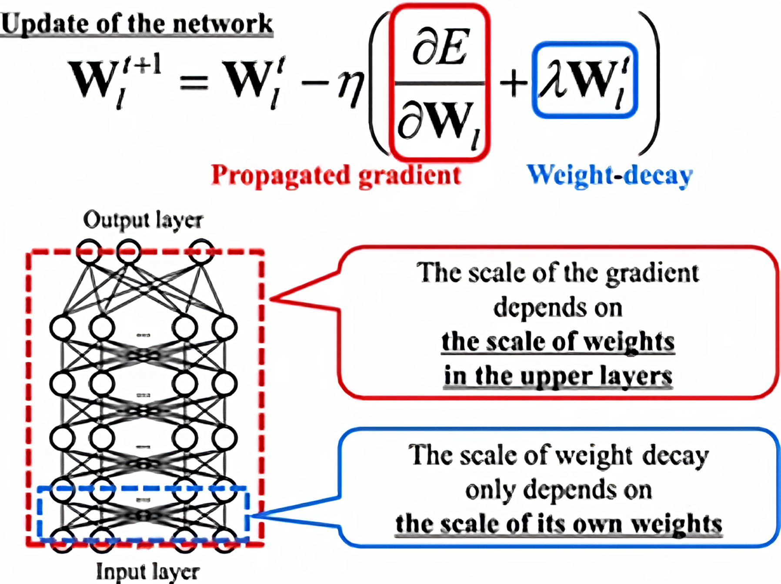
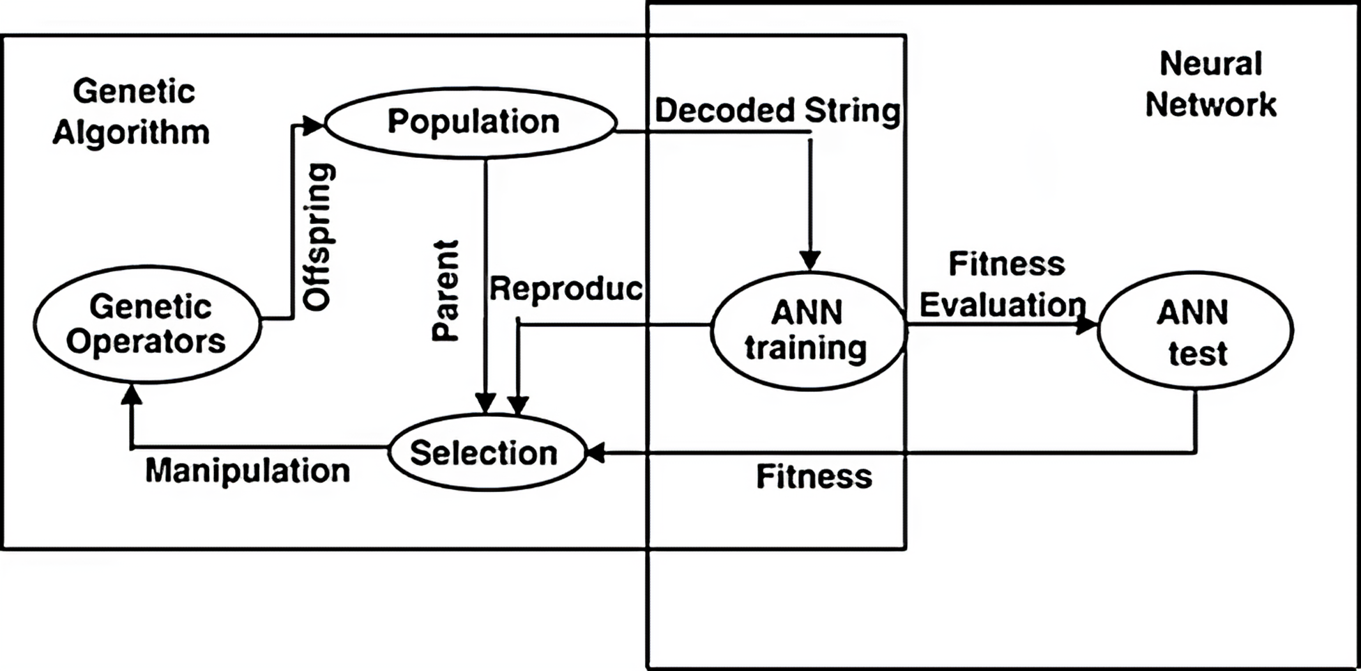
MLP
MLP/6_1: Basic MLP Model
MLP/6_2: With Kaiming Initialization
Two hidden layers with a hidden size of 128
For relu, keep the input and output conform Gaussian distribution, which may help improve model performance
MLP/6_3: With Weight Decay
Adjust the influence of model complexity on the loss function, let the weight decay to a smaller value, and alleviate the problem of model overfitting
MLP/6_4: Use Genetic Algorithm to Update Weight
The weight update by genetic algorithm can effectively solve the problem of gradient disappearance.[3]

Slide 11
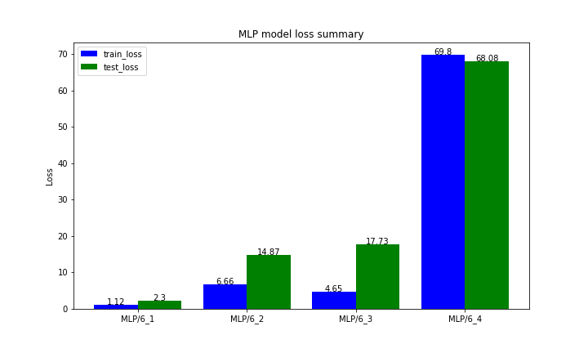
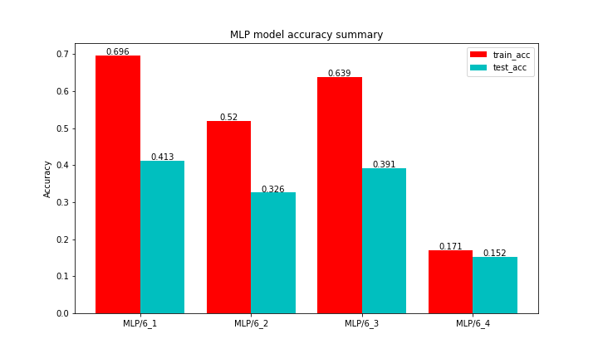
MLP
From the comparison between different models, the best baseline model is the model in 6.1.
The introduction of kaiming initialization and weight decay inhibits the improvement of model accuracy (whether it is a training set or a test set).
Also, the best MLP model only obtains ~40% accuracy on test dataset, which is unsatisfactory.

Slide 12
04
CNN

Slide 13
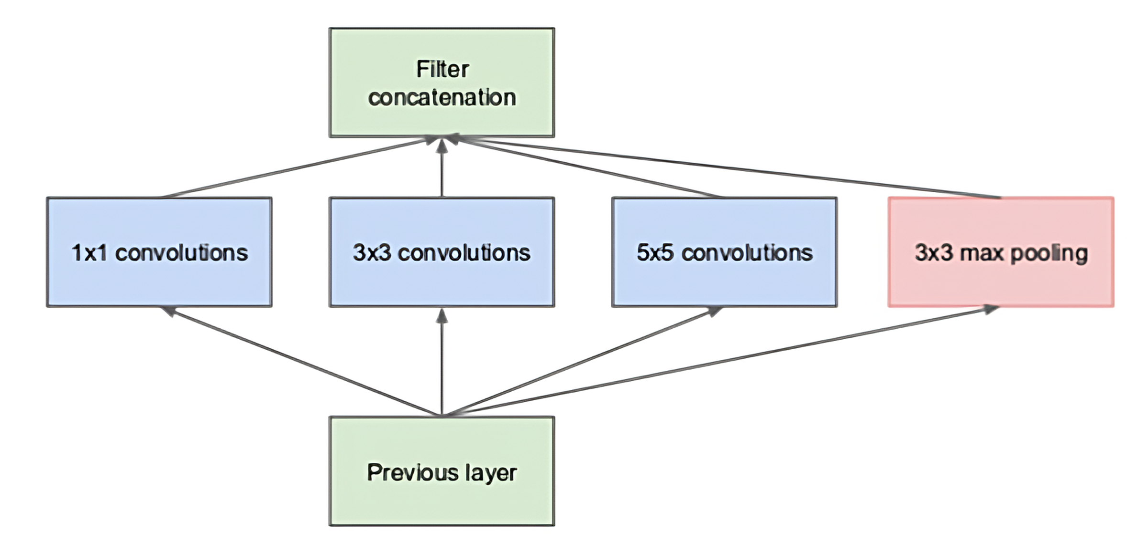
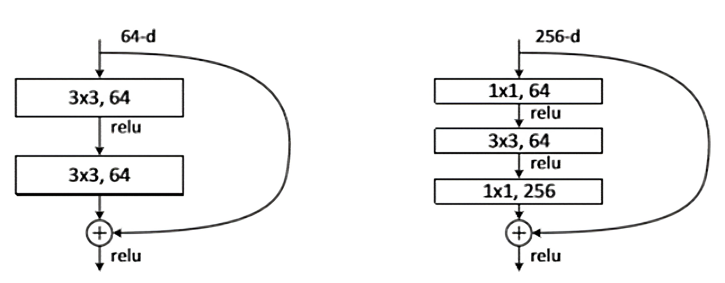
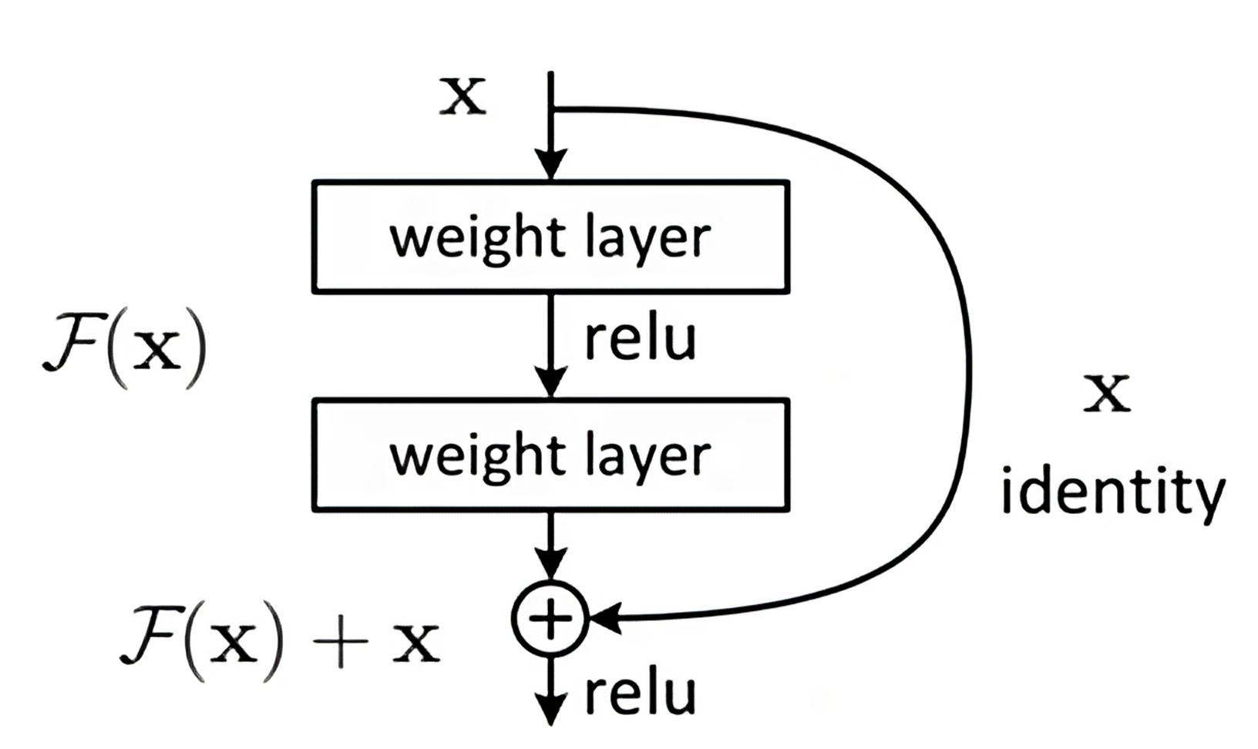
CNN
CNN/7_2: Inception
CNN/7_1: Basic CNN Model
The feature map of the same layer can use multiple convolution kernels of different sizes to obtain features of different scales, and then combine these features to obtain better features than those using a single convolution kernel.
One convolution layer with a hidden size of 128
CNN/7_3: Inception+Bottleneck
If only introducing convolution kernels of multiple sizes, it will bring a lot of extra parameters.
In order to solve this problem, some 1×1 convolution kernels can be added to the Inception structure.
CNN/7_4: Resnet
Resnet adds the input to output and makes it easier for gradients to flow into shallow networks.

Slide 14
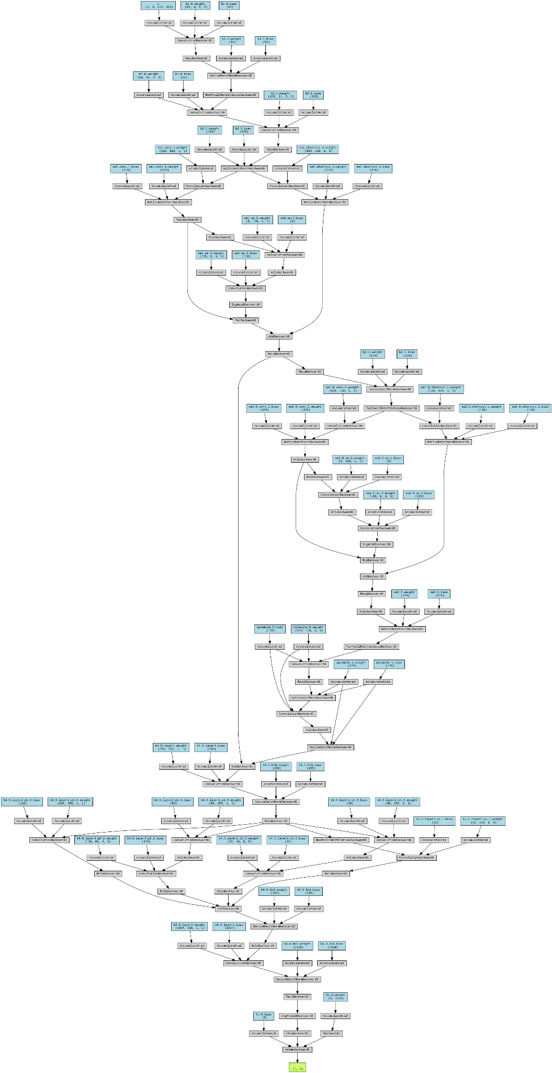
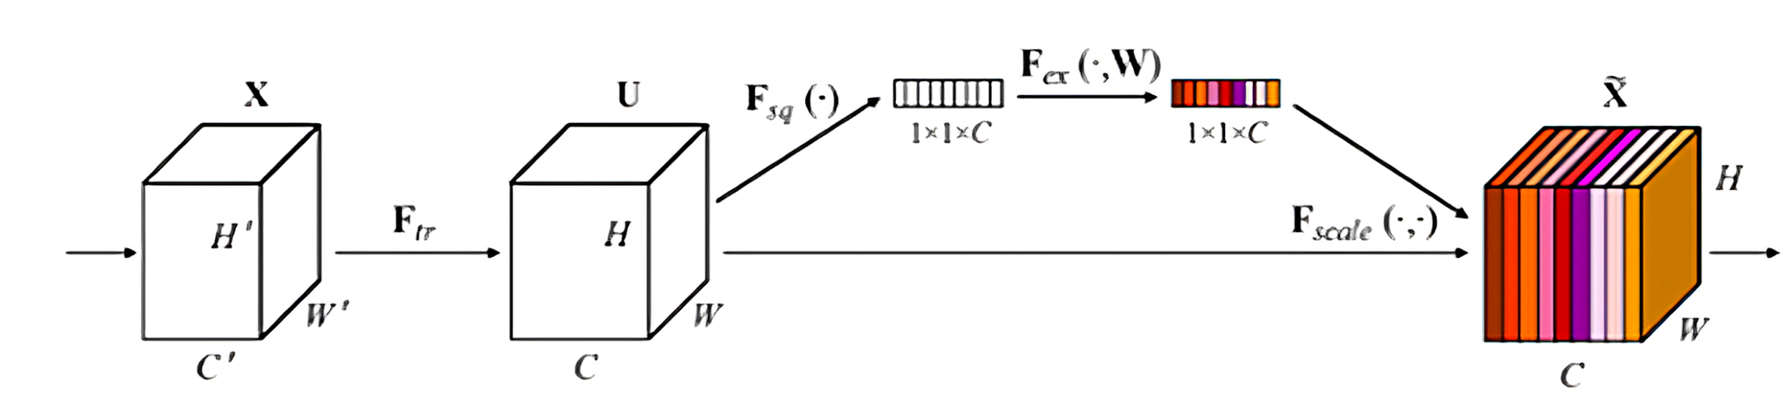
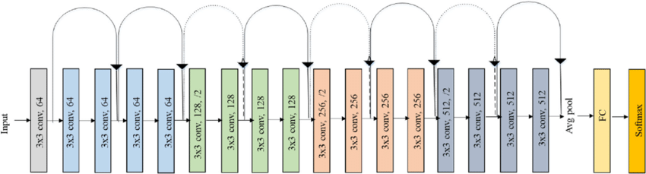
CNN
CNN/7_5: Sesnet
CNN/7_6: Combination of four structure
CNN/7_7: Resnet18 [4]
The idea of Senet is to obtain the importance of each feature channel by learning. Then, according to this importance, useful features are promoted and invalid features are suppressed.
The idea is similar to adding attention to different channels.

Slide 15
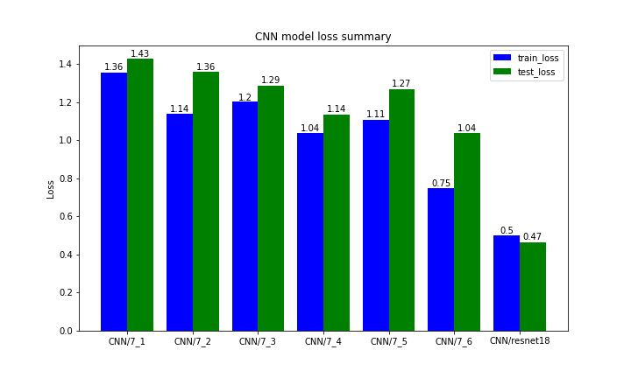
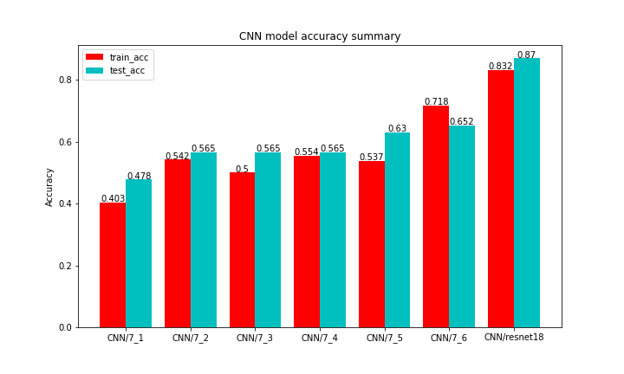
CNN
We have trained seven different models. Compared to the basic one CNN/7_1, other models have certain performance improvements. The resnet18 model using transfer learning achieved the highest accuracy of 0.87 on the test dataset.
We extend the model in both width and depth directions. After we incorporate these four tricks into one model CNN/7_6, the high accuracy on the training set indicates that the model can better learn the features of the images. Also the performance on the test set also has a certain improvement. It is believed that with reasonable stacking and structural mixing, this model can perform better.
Model CNN/resnet18 gets an accuracy of 0.87 on the test dataset, which is twice that of the most basic MLP model. It is proved to be a effective model in our research.

Slide 16
05
ANN

Slide 17
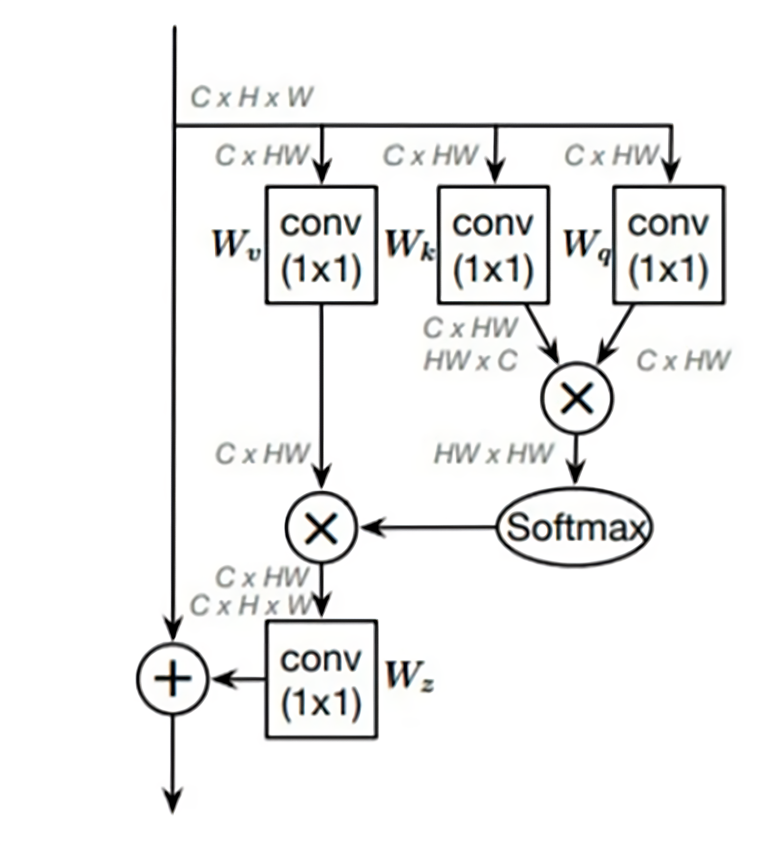
ANN
Non Local Block
The idea of non-local block is that the output of each position of a given tensor is the weighted of all the other position of the previous tensor. In this way, the output tensor captures the non-local information.
Using resnet-18, we plugged in this non-local block after each residual stage to enhance feature extraction.

Slide 18
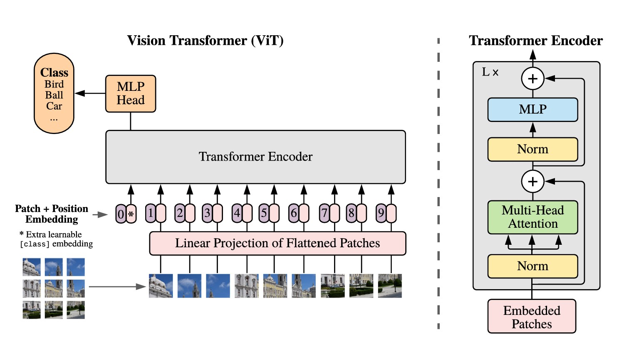
Vision Transformers
ViT is the state-of-the-art technique in Computer Vision. It firist splits the input image into different patches, and then use transformer layers to capture the different global correlation of different patches of the input feature map.
Besides, it uses multi-head self attention to further improve the performance.

Slide 19
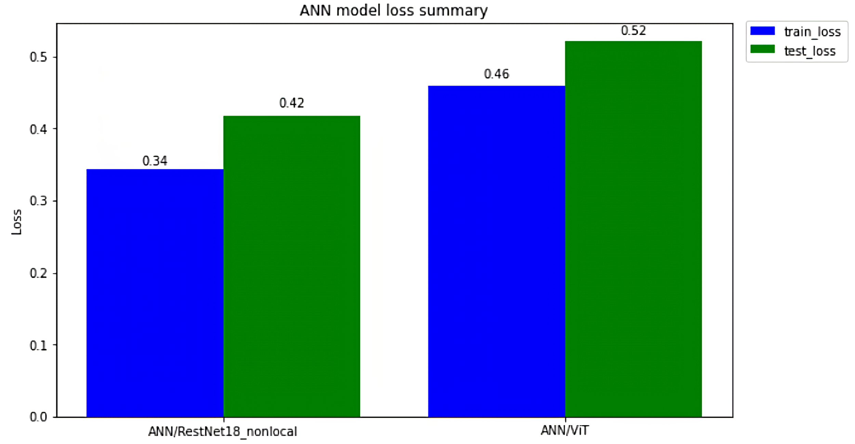
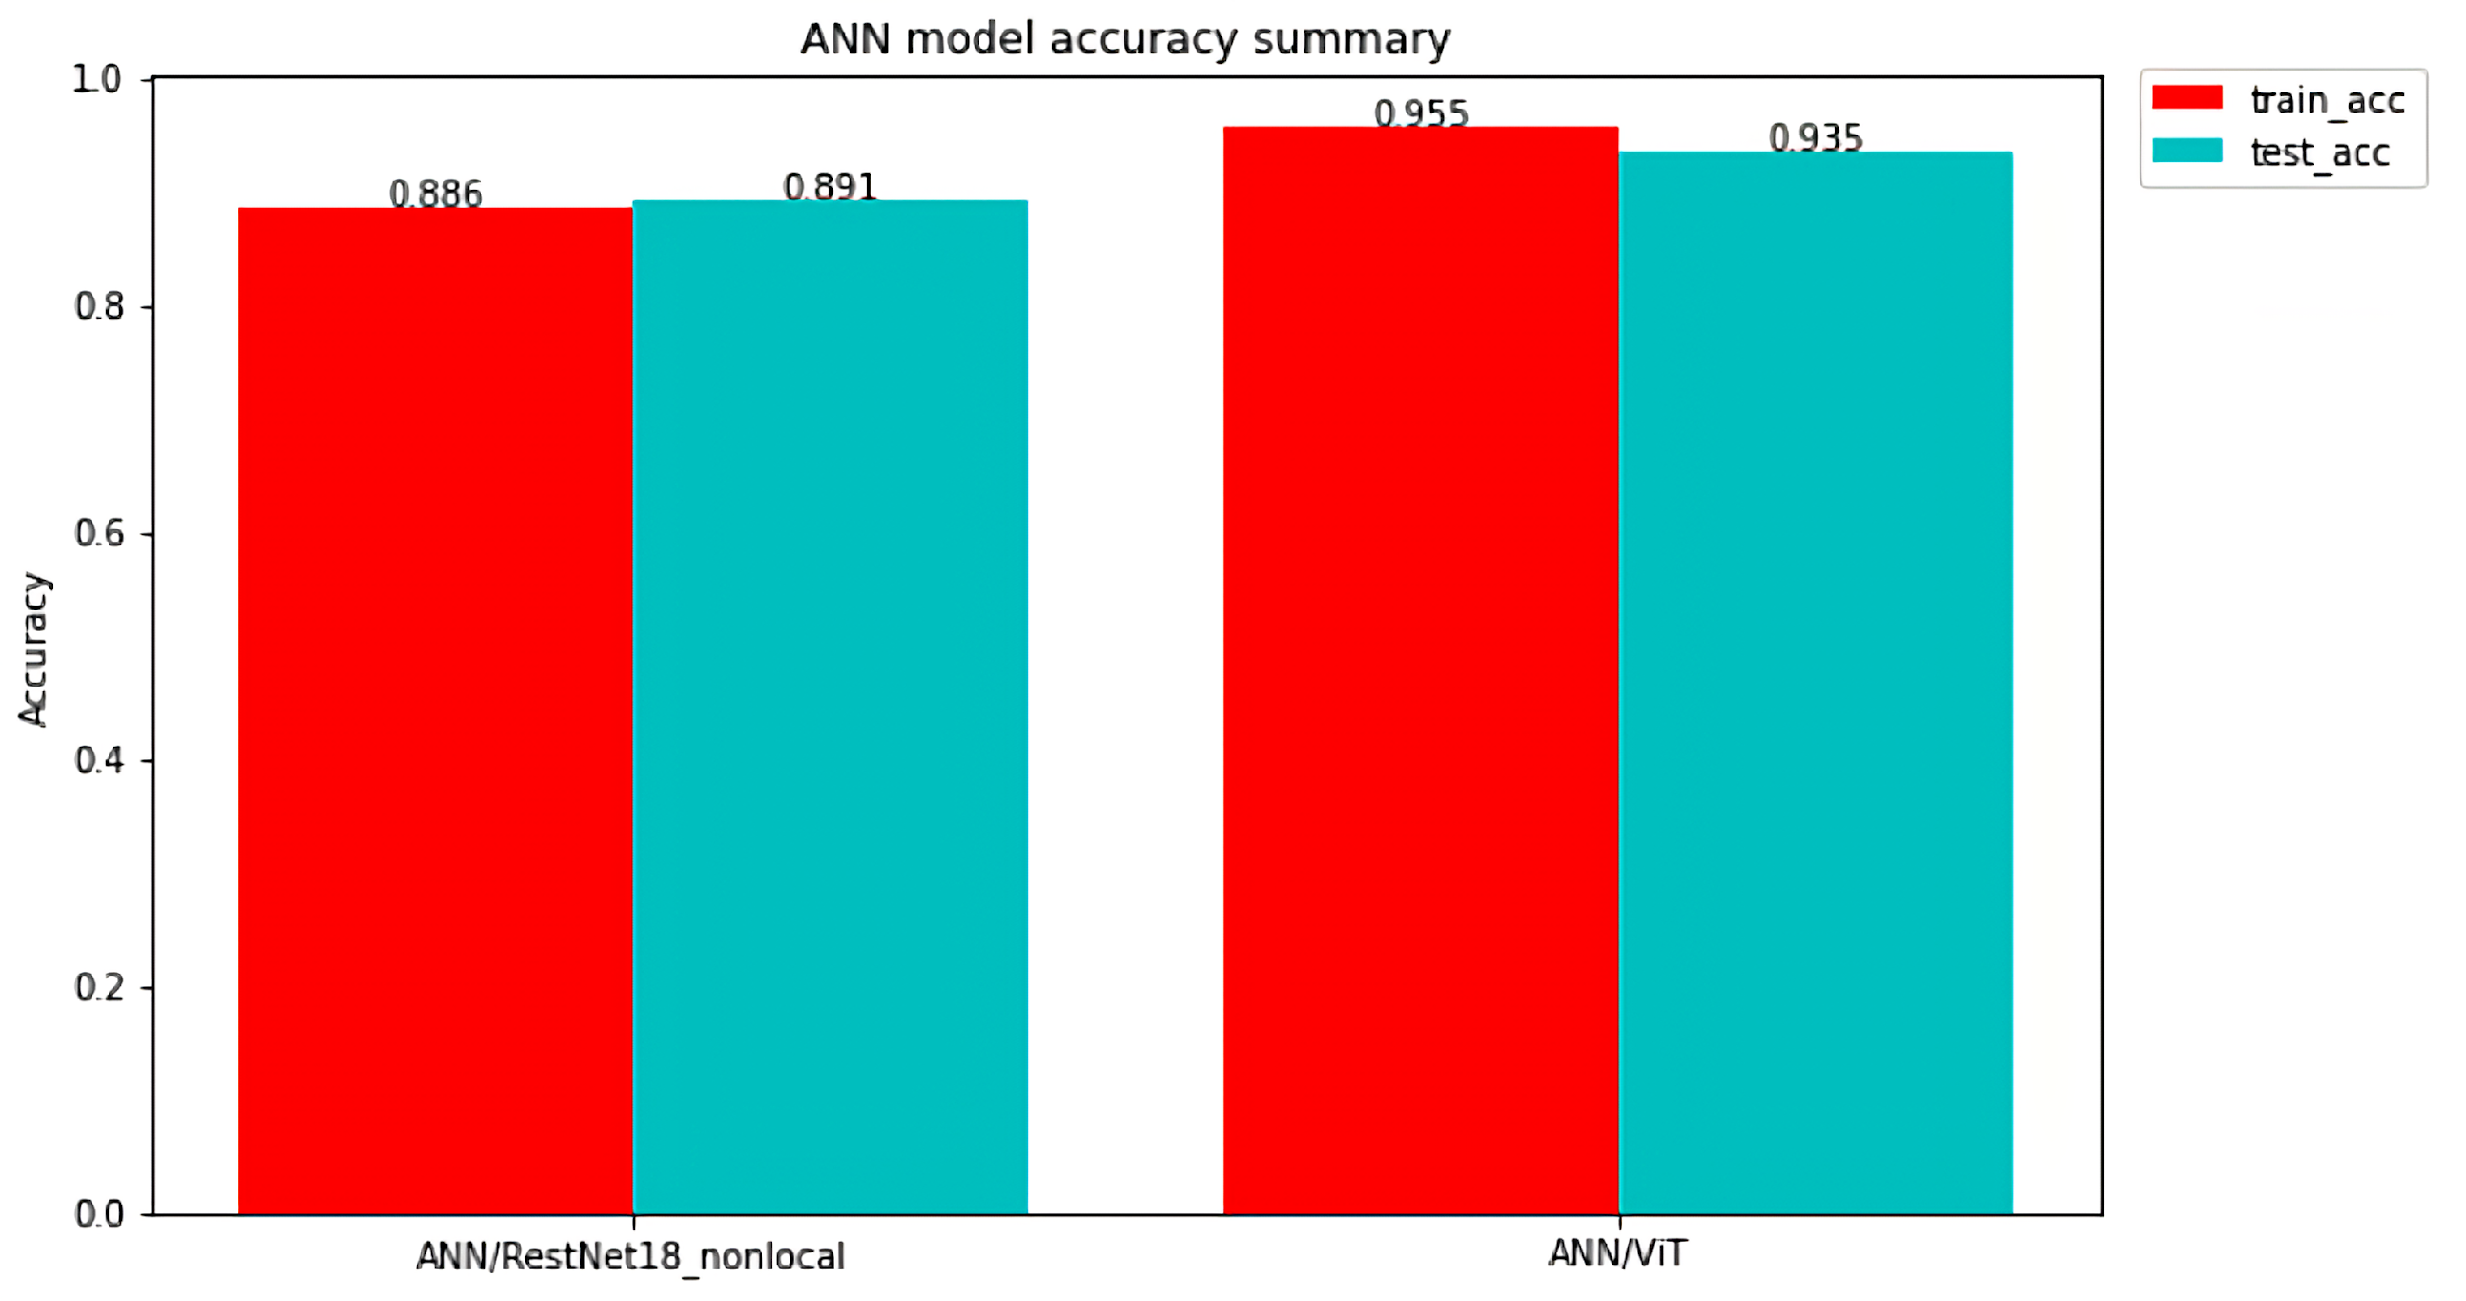
ANN
The state-of-the-art visual-transformer which does not use traditional CNN architecture and only used stacked self attention block. This method outperforms all other method in terms of the accuracy on the test set by achieving an accuracy of 0.935 on the test set.

Slide 20
06
Visualization

Slide 21
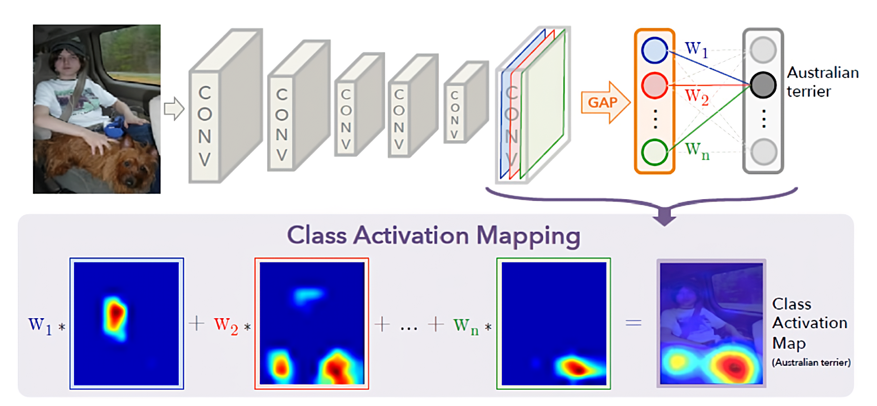
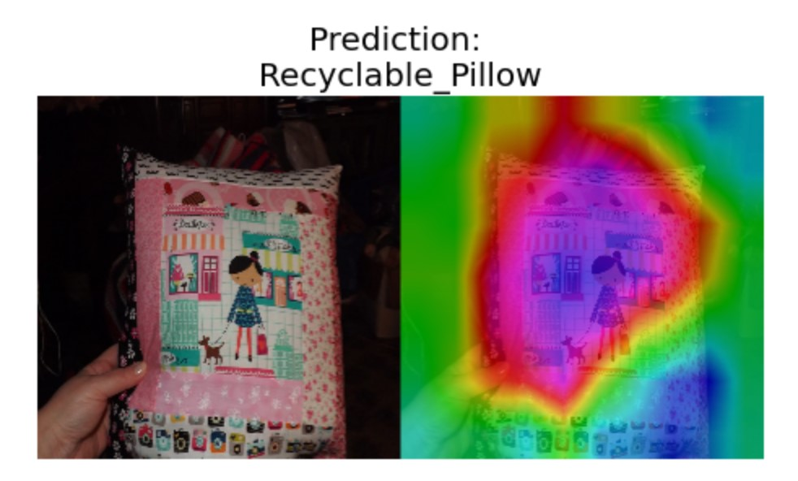
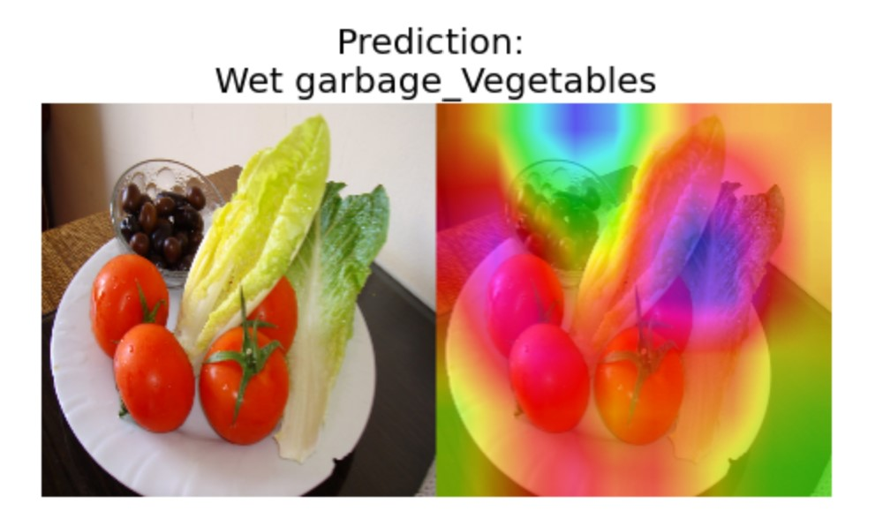
Neural Network Interpretability
√ Class Activation Map
Class Activation Map is a technique used to interprete what happened in the neural network. The redder the color is, the more important feature the neural network indicates.

Slide 22
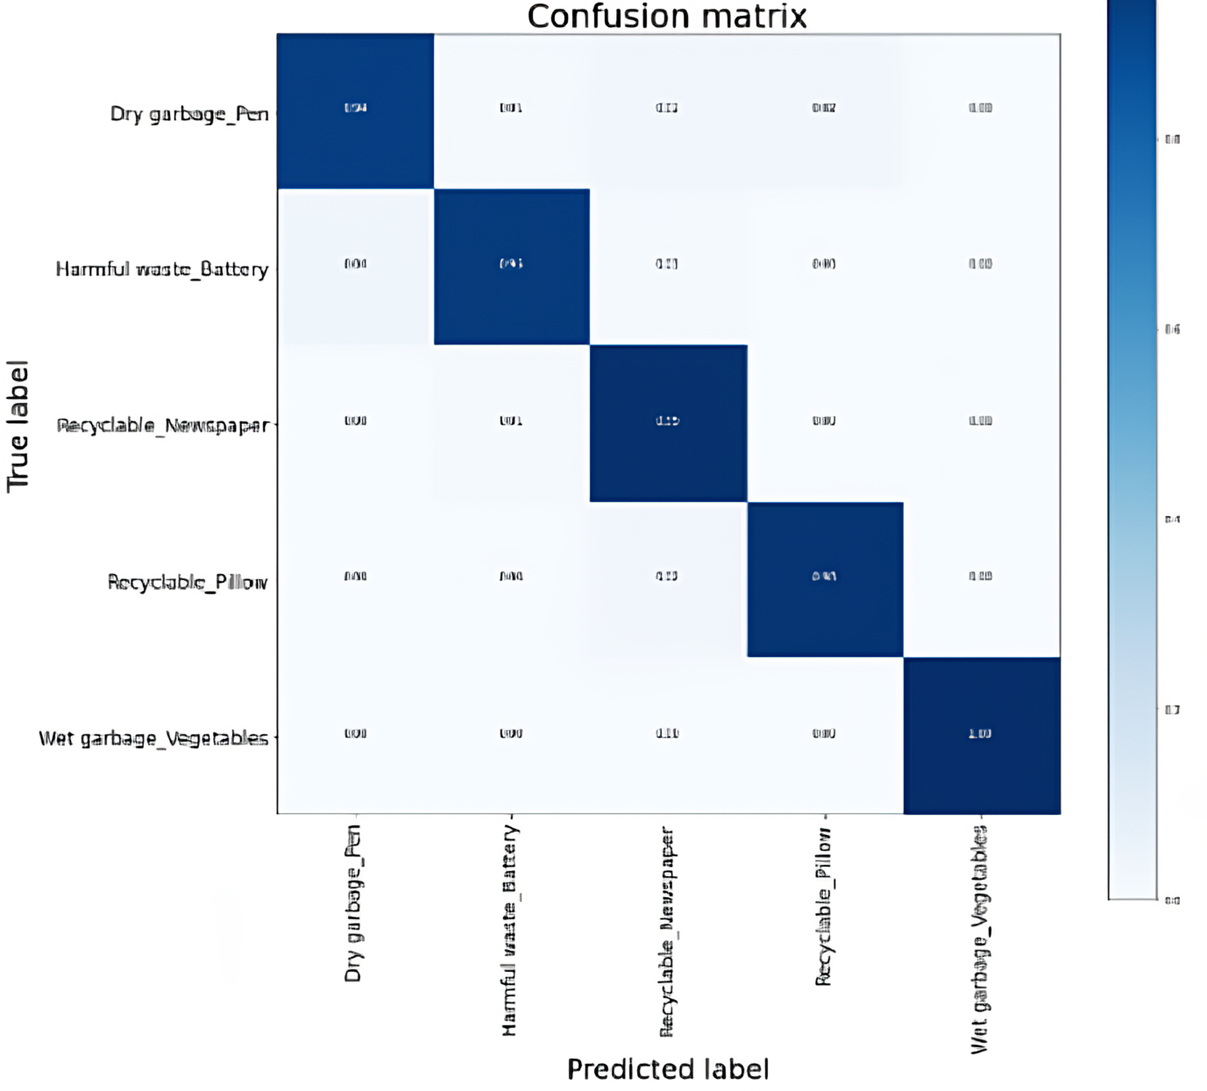
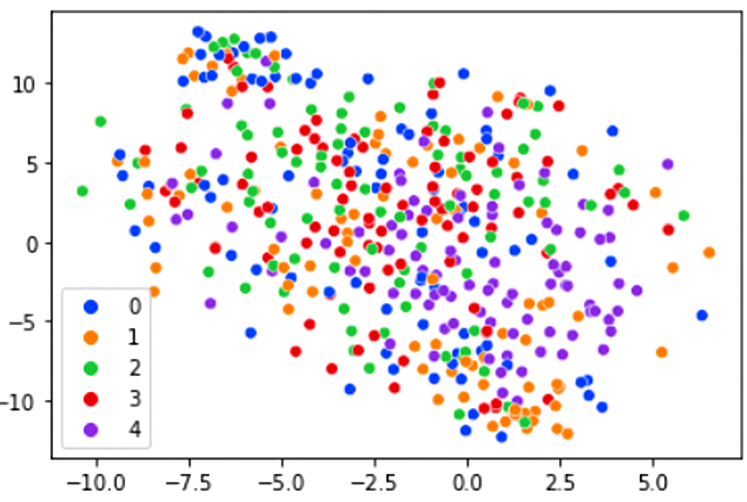
Visualization
√ Confusion Matrix
A specific table layout that allows visualization of the performance of an algorithm, typically a supervised learning one. Each row of the matrix represents the instances in an actual class while each column represents the instances in a predicted class, or vice versa.
Vegetables predict the best.
√ t-SNE
t-SNE is a tool to visualize high-dimensional data. It converts similarities between data points to joint probabilities and tries to minimize the Kullback-Leibler divergence between the joint probabilities of the low-dimensional embedding and the high-dimensional data.

Slide 23
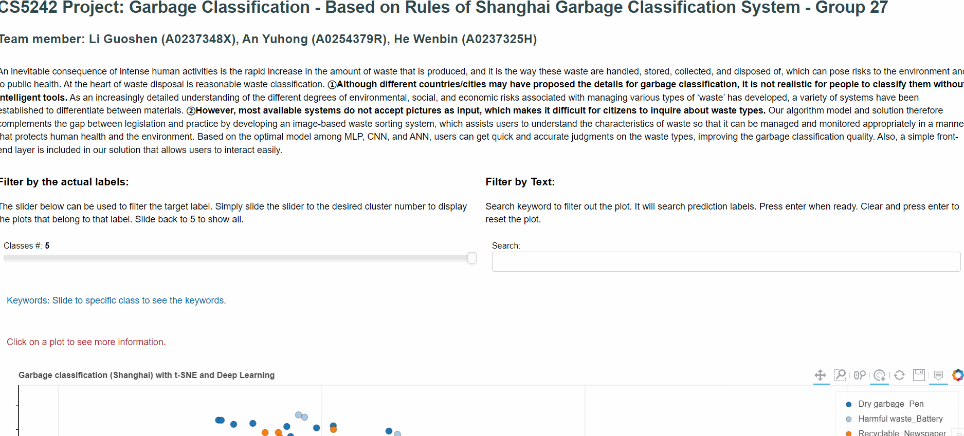
Visualization
√ Bokeh
Bokeh is a Python library for creating interactive visualizations for modern web browsers. It helps you build beautiful graphics, ranging from simple plots to complex dashboards with streaming datasets. With Bokeh, you can create JavaScript-powered visualizations without writing any JavaScript yourself.

Slide 24
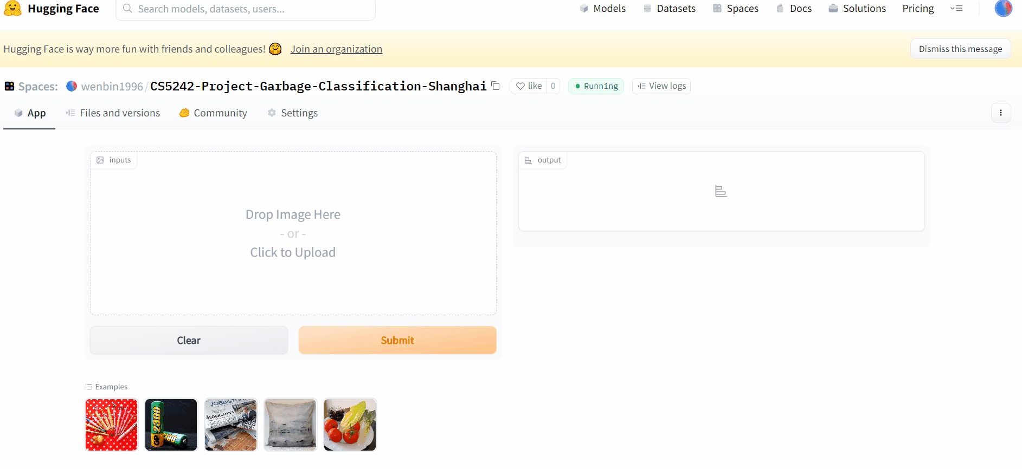
Visualization
√ Gradio
Gradio is the fastest way to demo your machine learning model with a friendly web interface so that anyone can use it, anywhere. And we deploy the model on Hugging Face to realize the function of online prediction.

Slide 25
07
Conclusion

Slide 26
Conclusion
Data Sources
Shanghai Garbage Classification System
Flickr API
Data Sources
Model Highlights
Pre-processing: Kmeans, high similarity, G-Smote …
MLP、CNN、ANN
Model Highlights
Visualization & Online App
Bokeh iterative plot
Gradio online prediction
Visualization & Online App

Slide 27
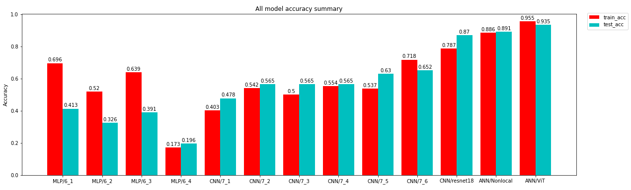
Conclusion
Based on Shanghai Garbage Classification System, we propose our solution to help citizens to obtain the accurate trash type based on the images so that the difficulty of protecting environment is lower. We Fetch the images of garbage by designing our scrawler and modify their labels like Recyclable - Glasses to adapt our multi-class garbage classification model. And some data pre-preprocessing technologies, such as Kmeans, Geometric Smote, etc., are used in our research. Based on the optimal model among MLP, CNN, and ANN, users can get quick and accurate judgments on the waste types, improving the garbage classification quality.

Slide 28
References
[1] Yang, J., Zeng, Z., Wang, K., Zou, H., & Xie, L. (2021). GarbageNet: a unified learning framework for robust garbage classification. IEEE Transactions on Artificial Intelligence, 2(4), 372-380.
[2] Ishii, M., & Sato, A. (2017, November). Layer-wise weight decay for deep neural networks. In Pacific-Rim Symposium on Image and Video Technology (pp. 276-289). Springer, Cham.
[3] Jahed Armaghani, D., Hasanipanah, M., Mahdiyar, A., Abd Majid, M. Z., Bakhshandeh Amnieh, H., & Tahir, M. (2018). Airblast prediction through a hybrid genetic algorithm-ANN model. Neural Computing and Applications, 29(9), 619-629.
[4] Ramzan, F., Khan, M. U. G., Rehmat, A., Iqbal, S., Saba, T., Rehman, A., & Mehmood, Z. (2020). A deep learning approach for automated diagnosis and multi-class classification of Alzheimer’s disease stages using resting-state fMRI and residual neural networks. Journal of medical systems, 44(2), 1-16.

Slide 29
Thanks
For you watching
CS5242 Group27

